Slide 1

AI MEAL COACH : A NUTRITION DIET/RECOMMENDATION SYSTEM
Theme: Good Health and Well-Being
Category: Software
Group Number: 11
Group Members: Gaurav Kshirsagar, Prajwal Dhanawade, Tarun Pandey
Guide: Dr. Rahul Ambedkar

Slide 2
Introduction:
In today’s fast-paced lifestyle, people consume food without knowing its nutritional value, leading to lifestyle diseases such as obesity, diabetes, and malnutrition. Maintaining a balanced diet has become difficult due to lack of awareness and real-time nutritional guidance.
Manual calorie tracking is time-consuming and inconvenient.
People lack awareness of their daily nutritional intake and personalized guidance
Detects food from images and estimates nutrition automatically.
Provides smart recommendations to promote healthy living (SDG 3).

Slide 3
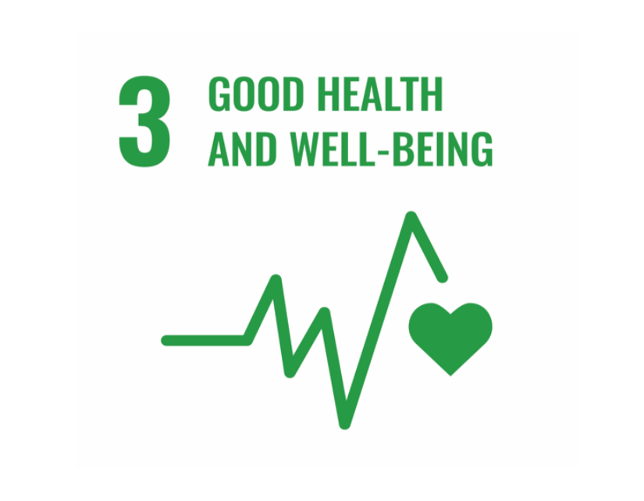
Sustainable Development Goal:
SDG 3 (Health): Promotes healthy eating and preventive care
SDG 2 (Zero Hunger): Improves nutritional awareness
SDG 9 (Innovation): Uses AI for real-time food analysis
SDG 12 (Consumption): Encourages mindful eating habits

Slide 4
Literature Survey:
Title | Conference / Journal Details | Key Points | Improvements Proposed
[1]Food Image Recognition Using Deep Learning | Published in 2019 | Uses CNN for food classification. Focuses mainly on image recognition | Integrate portion counting and calorie estimation. Integrate with personalized health recommendation
[2]Calorie Estimation from Food Images | Published in 2020 | Uses image segmentation for portion estimation. Requires controlled image conditions | Use object detection (YOLO) for real-time detection
[3] Mobile-Based Diet Monitoring System | Published in 2021 | Relies on manual food entry. No automatic image recognition | Reduce manual effort. Provide smart ML-based recommendation
[4] AI-Based Personalized Diet Recommendation | Published in 2022 | Depends on structured dataset. Predicts diet categories based on user data | Automatically generate dataset from food intake. Improve prediction using real user history
[5] YOLO for Real-Time Object Detection | Published in 2022 | High speed and good accuracy | Fine-tune YOLO for food-specific dataset

Slide 5
Limitations in Existing Systems:
Heavy dependency on manual calorie logging.
Inaccurate portion size and macro-nutrient estimation.
Lack of personalized dietary recommendations
Separate systems for detection and recommendation (not integrated).
Performance drops when dataset is too small or too high or imbalanced.

Slide 6
Problem Statement:
Many people are unaware of the actual nutritional value of the food they consume daily. Existing calorie-tracking applications require manual entry of food names and portion sizes, which is time-consuming and often inaccurate. This makes it difficult for individuals to consistently monitor their dietary intake and maintain a balanced diet. Therefore, there is a need for an intelligent, automated system that can detect food items directly from images and estimate their nutritional values to support healthier lifestyle decisions.

Slide 7
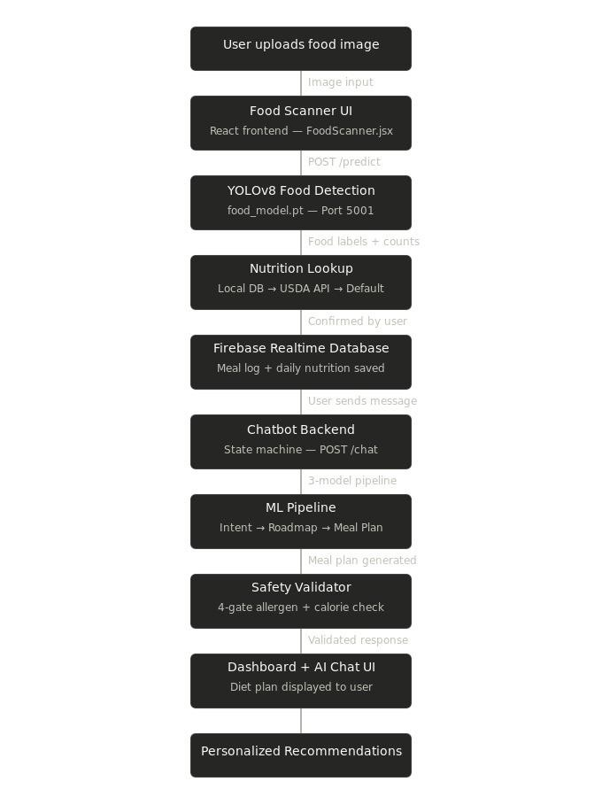
Proposed System:

Slide 8
User provides input either through Image Upload or Manual Entry.
Image input is processed using YOLO model to detect food labels and counts.
Manual input directly captures food name and quantity.
Detected food items are mapped to a Nutrition Reference Dataset containing protein, carbohydrates, fat and sugar values. This is a stable dataset
Total calories are calculated using the formula: Calories = (Protein × 4) + (Carbohydrates × 4) + (Fat × 9)
Final output provides a dietary recommendation.

Slide 9
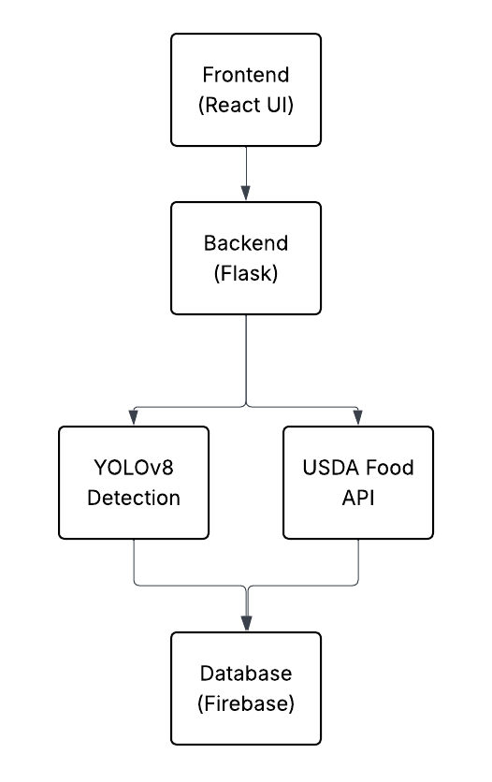
Experimental Setup:
Frontend:
React: Sends input data to backend API and displays results.
Handles image upload and manual food entry.
Backend:
Python (Flask): Handles API requests and model integration.
YOLOv8 (Ultralytics): Performs food detection and counting.
Firebase: Database.

Slide 10
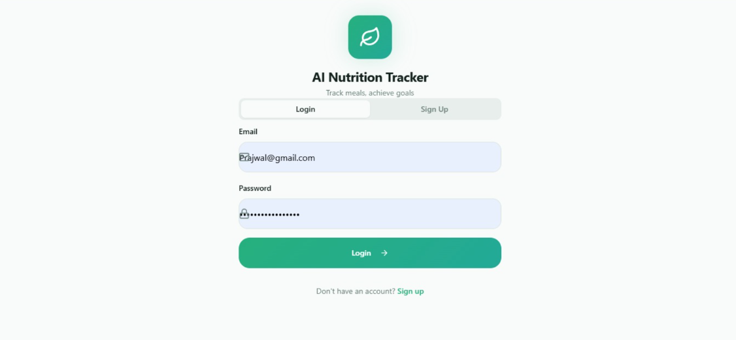
Implementation:

Slide 11
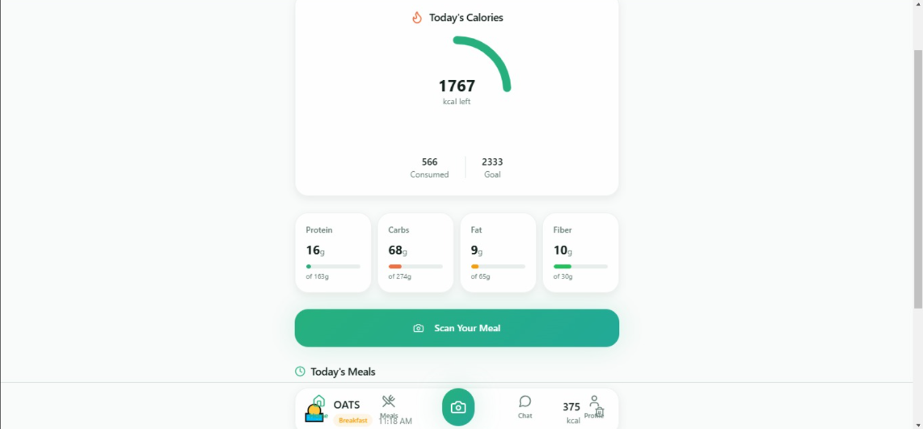

Slide 12
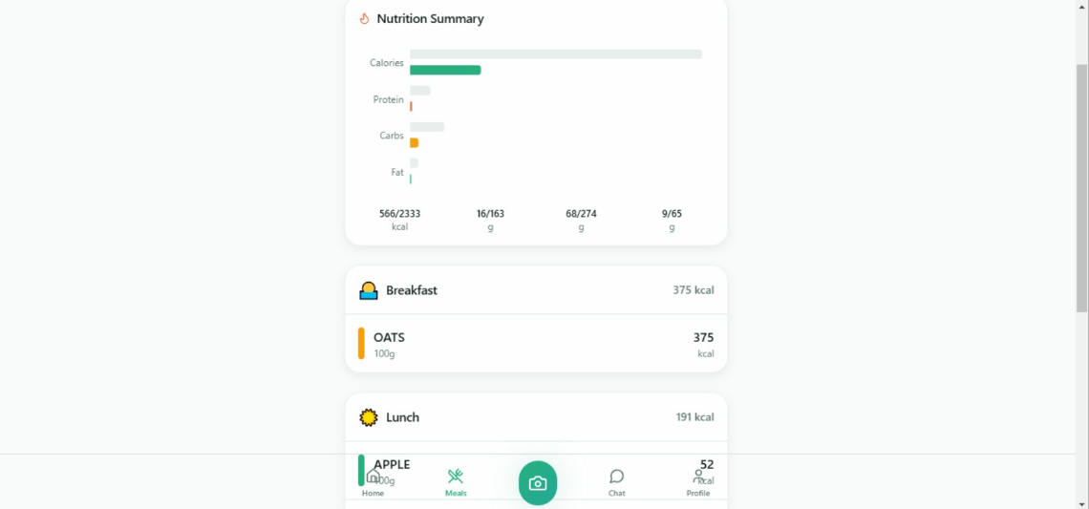

Slide 13
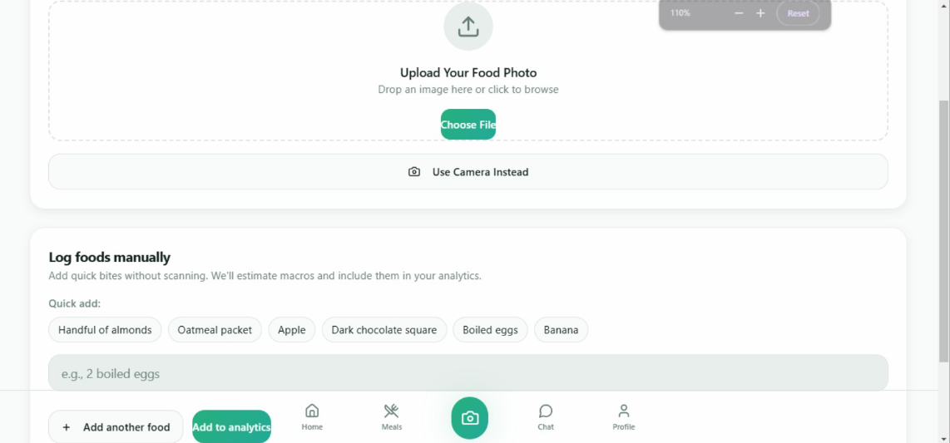

Slide 14
Conclusion:
The AI-based Nutrition Estimation System enables automatic food detection and calorie calculation using image recognition.
It reduces manual effort in tracking nutrition by providing instant macronutrient analysis.
The system integrates YOLO-based food detection and personalized diet plan to support better dietary decisions.
Overall, the project delivers a smart, practical, and user-friendly solution for daily nutrition monitoring.

Slide 15
Future Scope:
Integration with real-time health devices (smartwatch, fitness bands).
Deployment as a mobile application for wider accessibility.
Expansion of dataset with more food categories and portion estimation.
Advanced personalized diet planning using deep learning models.
Cloud deployment for scalable user data management.

Slide 16
Research & References:
[1] L. Breiman, "Random Forests," Machine Learning, vol. 45, no. 1, pp. 5–32, 2001, doi: 10.1023/A:1010933404324.
[2] G. Jocher et al., "Ultralytics YOLOv8," Ultralytics, 2023. [Online]. Available: https://docs.ultralytics.com
[3] H. Jiang, C. Xu, and W. Zhao, "DeepFood: Food Image Analysis and Dietary Assessment via Deep Model," in Proc. IEEE International Conference on Multimedia and Expo (ICME), 2020, pp. 1–6, doi: 10.1109/ICME46284.2020.9102956.
[4] Y. Kawano and K. Yanai, "Real-Time Mobile Food Recognition System," in Proc. IEEE Conference on Computer Vision and Pattern Recognition Workshops (CVPRW), 2013, pp. 1–7.
[5]A. Vaswani et al., "Attention Is All You Need," in Advances in Neural Information Processing Systems (NeurIPS), vol. 30, 2017, pp. 5998–6008.

